Slide 1
Royal life saving society uk’s primary school water safety presentation

Slide 2
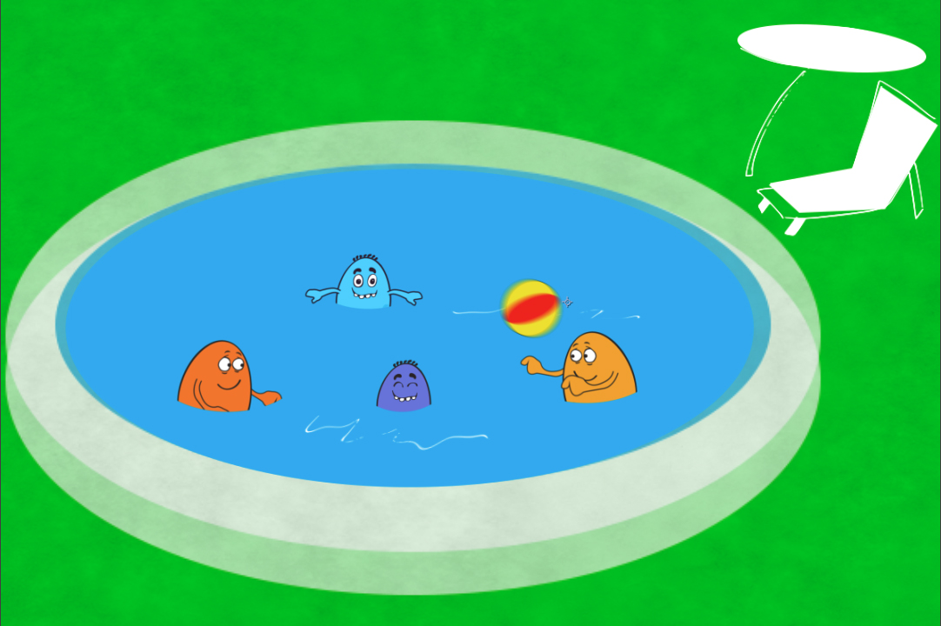
Water is fun
Notes:
Ask them what fun things they do in the water. Prompt them by asking who goes swimming, who goes to the beach, who walk near rivers etc.

Slide 3
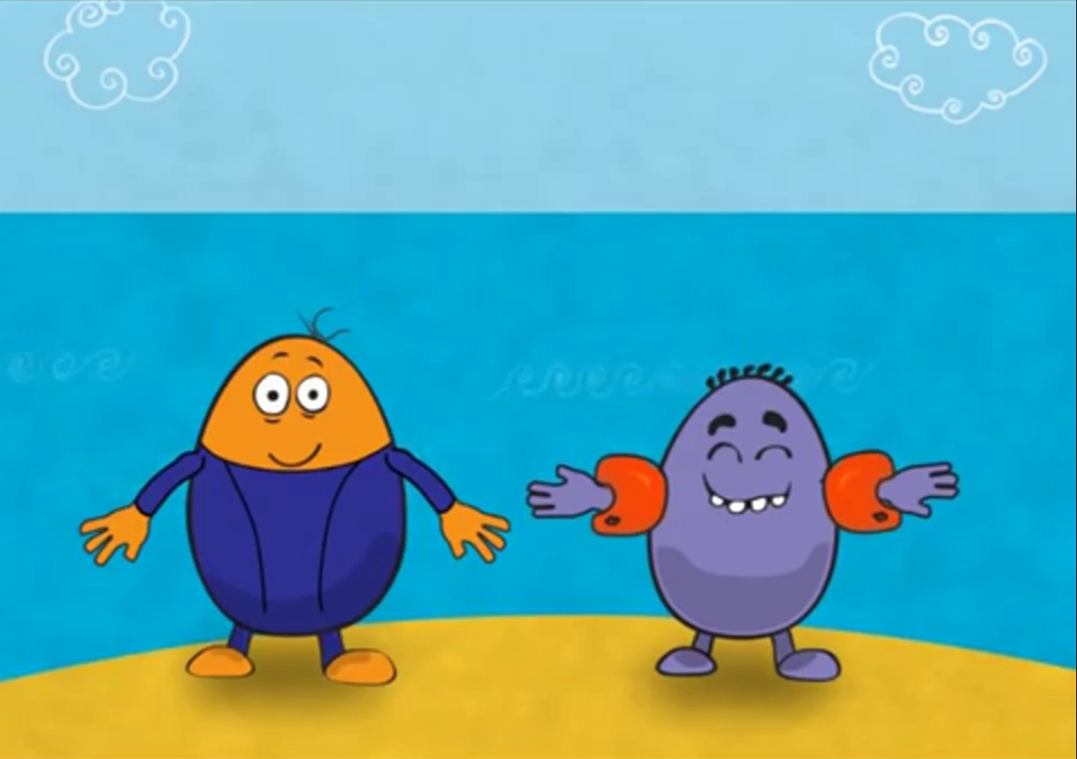
Stay safe
Notes:
Emphasise that they need to make sure they stay safe near or in water.

Slide 4
THE Water Safety CODE
Notes:
Explain that you’re going to teach them the Water Safety Code.

Slide 5

Notes:
Play film

Slide 6
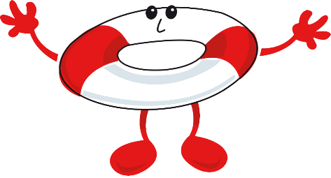


Stop and think
THINK
Notes:
Ask children to shout out some of the things that can go wrong

Slide 7
CAN YOU FIND ALL 8?
Running on SLIPPERY FLOORS
Glass by the pool
Jumping IN to SHALLOW WATER
STAY AWAY FROM BOTTOM OF SLIDES
Unaccompanied CHILDREN
Drifting INTO DEEP WATER/diving area
Swimming IN THE DIVING AREA
DEEP WATER
Notes:
The teacher or pupils can click (or touch) where they think there is a danger, then the information notice will appear.
Pupils can discuss each of the dangers and how they would keep themselves safe.

Slide 8

Cold WATER
Notes:
Explain that in a pool the water is warm but in water found outside, it is very cold even in the summer

Slide 9
CAN YOU FIND ALL 8?
Unknown depth
(Too deep or shallow)
UNSAFE BANKS
WHAT’S IN THE WATER?
Not Wearing A LIFE JACKET
BROKEN lifesaving equipment
Pets near the water without leads
Running NEAR THE EDGE
Cycling NEAR WATER
Notes:
The teacher or pupils can click (or touch) where they think there is a danger, then the information notice will appear.
Pupils can discuss each of the dangers and how they would keep themselves safe.

Slide 10
CAN YOU FIND ALL 13?
CURRENTS and wind
Cliff jumping
Swimming
TOO SOON
AFTER EATING
BEWARE OF DEEP WATER
Drifting out too far
Surfers in swimming zone
UNSAFE EDGES
Drinking ALCOHOL in or near water
Not Wearing SUN CREAM
Not wearing safety equipment
PIPES
Unaccompanied children
Swimming in the red flag zone
Notes:
The teacher or pupils can click (or touch) where they think there is a danger, then the information notice will appear.
Pupils can discuss each of the dangers and how they would keep themselves safe.

Slide 11



STAY TOGETHER
Notes:
Emphasise importance of staying together. It’s more fun and if you get in trouble, they can help.

Slide 12
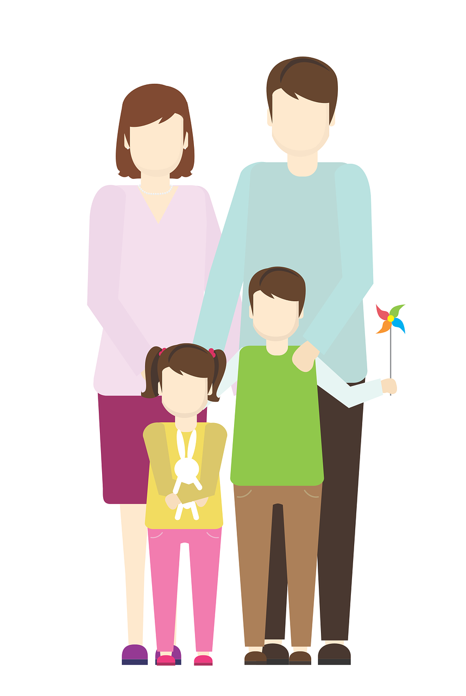

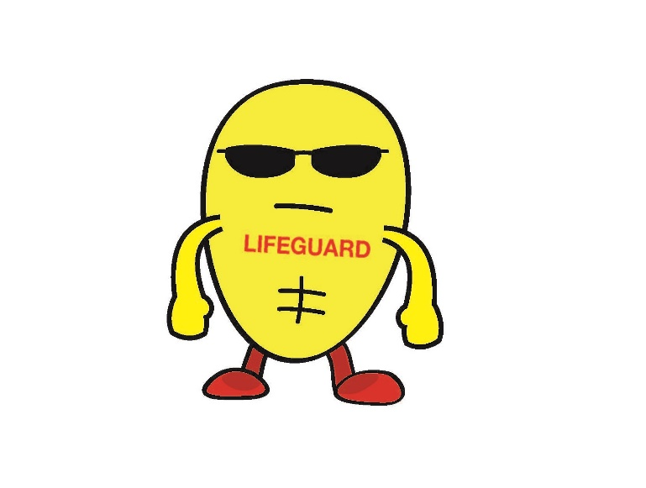
Who keeps you safe?
Lifeguards
Parents
Teachers
Notes:
Explain that at a pool and even on a beach there are people to keep them safe but there after them at places like rivers and canals, so they need to be extra careful.
Talk about who can keep them safe near water. Prompt who would be called to a rescue – fire service, coastguard etc.

Slide 13
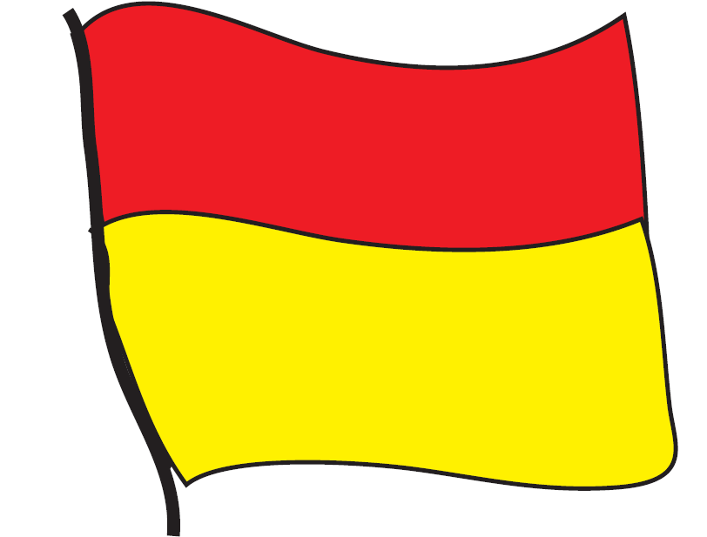

Beach Flags
Notes:
Ask them to shout out if they know what this Beach flag means. Emphasise that they should only swim between the red and yellow flags.

Slide 14
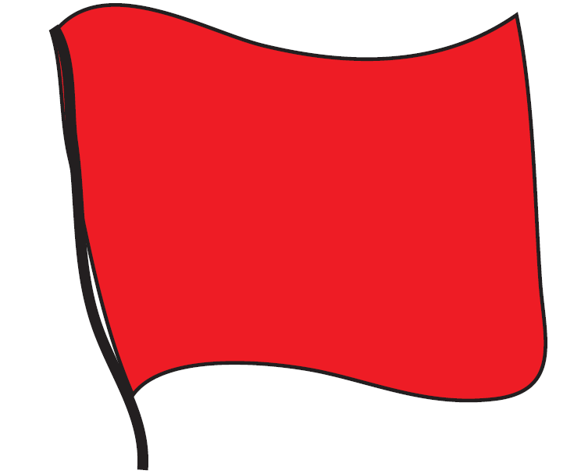
Beach Flags
Notes:
Ask them to shout out if they know what this Beach flag means. Emphasise that if there is a red flag showing, they should not swim. They can only swim when there are red and yellow flags showing.

Slide 15

Phone 999
999
Notes:
Get them to shout out what number they need to call.

Slide 16

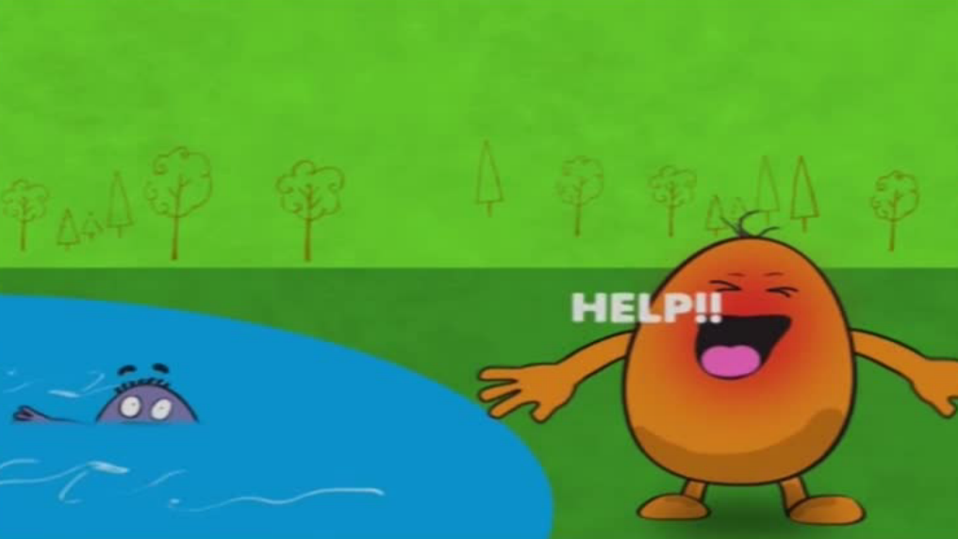
What to do
Don’t go in the water
Call for help
Notes:
Talk through what to do if they see someone in the water
OPTION - Demonstrate safe rescues (throw something that floats or carry out a reach rescue if the pupils are old enough) Emphasise that they shouldn’t attempt a rescue if its unsafe for them.

Slide 17


float
Royal Life Saving Society UK – www.rlss.org.uk
Notes:
Tell them that if they fall in, they need to try to relax and float
Tell them to throw something that floats to anyone in the water

Slide 18
?
?
?
?
?
?
?
?
?
Play Your Cards Right
Where do people drown?
Flip through the cards and decide whether you think the statistics get higher or lower
Notes:
Interactive Game – Play Your Cards Right
This goes through different locations people can drown.
Most drownings happen at inland water sites, like rivers, canals, quarries and reservoirs but people can drown anywhere where there is water

Slide 19

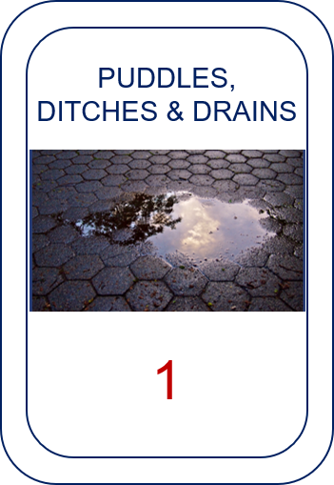

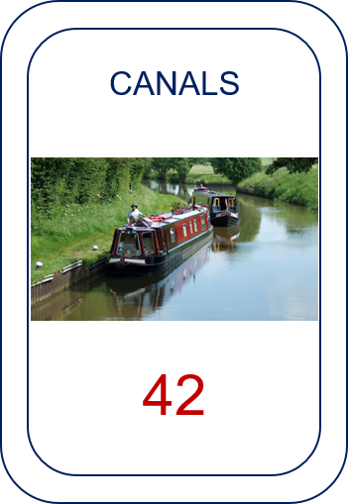
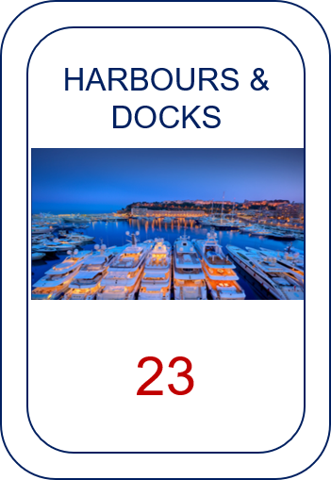
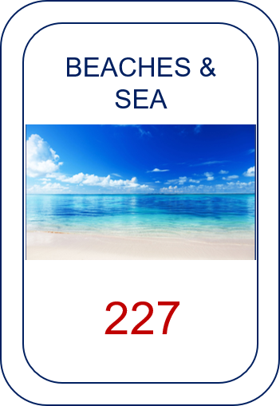


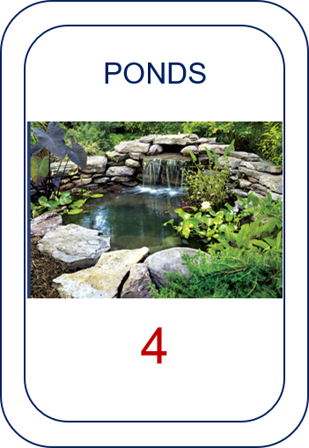
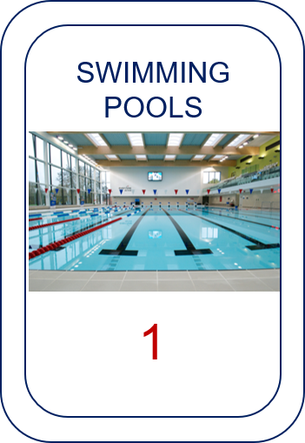
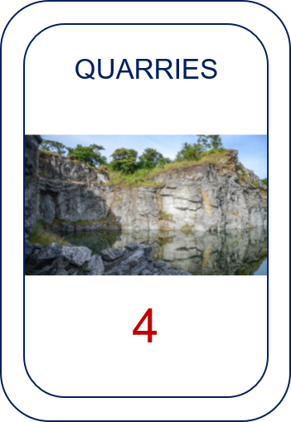










NEXT
Notes:
Hands on head for higher – hands on bums for lower.

Slide 20
Optional activities
Beach flags
Cold water
What sinks, what floats
Sort water spots into most –least dangerous
DRY-Side Activity cards
Classroom activity cards
Wet-side activity cards
Notes:
Get children to hold their hands in the water for 30 seconds and then try to undo a button
Ask children to try out different items to see which floats and which sinks – aims to get children thinking about how things can sink under the water
Use the Play your Card right print outs to sort which water spots are the most dangerous
Use the other DPW resources to compliment the presentation, such as the Dryside activities, Classroom activities or Wetside activities.

